Slide 1

DAVID LOPEZ
Y SUS
FACULTAMIGOS
SPRINT 2 - Weather App

Slide 2
PARTICIPANTES
David Lopez
Tomás Ferro
Sabrina Moreira
Damar Moran
Scrum Master
Product Owner
Team Member
Team Member

Slide 3
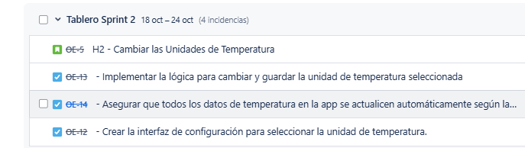
BACKLOG SPRINT 2

Slide 4
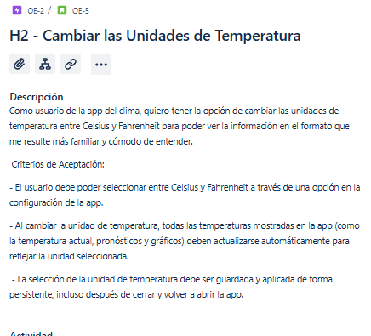
HISTORIA DE USUARIO N2

Slide 5
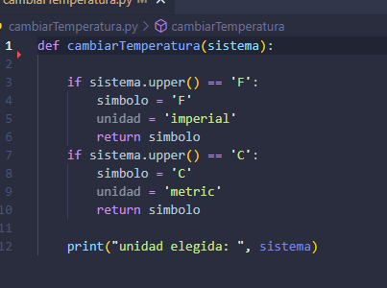

Slide 6
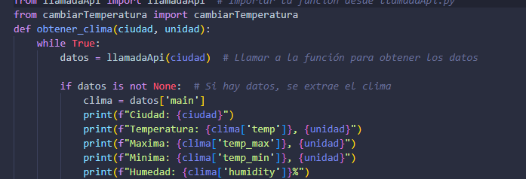
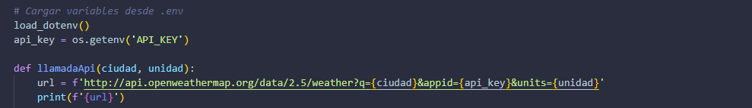

Slide 7
